Slide 1
Vet CDE Dog Breed

Slide 2
Sporting Group

Slide 3
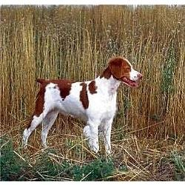
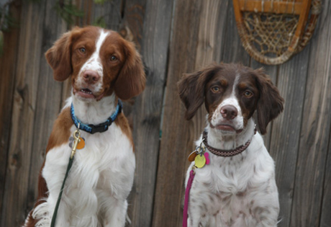
Brittany- 400

Slide 4
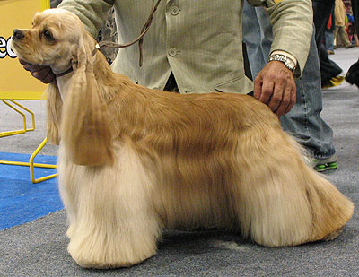
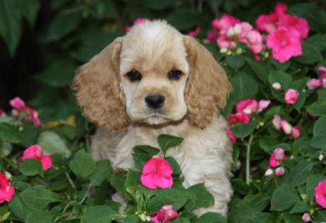
Cocker Spaniel-401

Slide 5
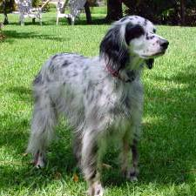
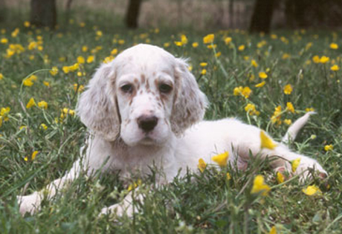
English Setter-402

Slide 6
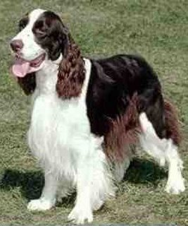
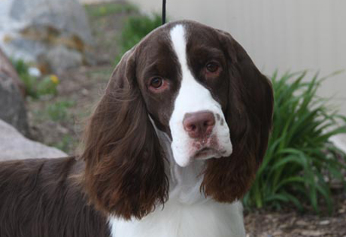
English Springer Spaniel-403

Slide 7
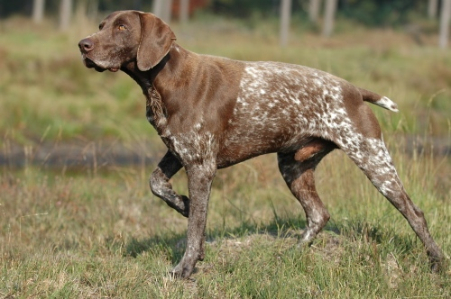
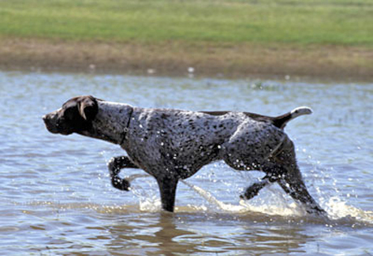
German Short Haired Pointer-404

Slide 8
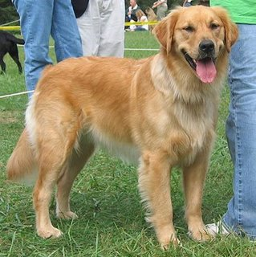
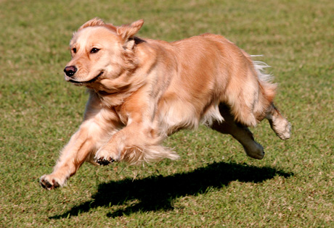
Golden Retriever-405

Slide 9
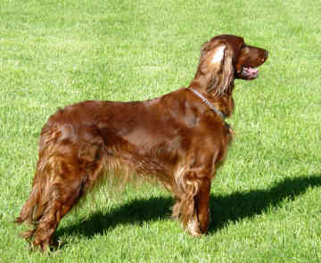
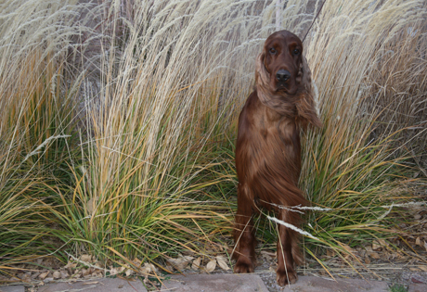
Irish Setter-406

Slide 10
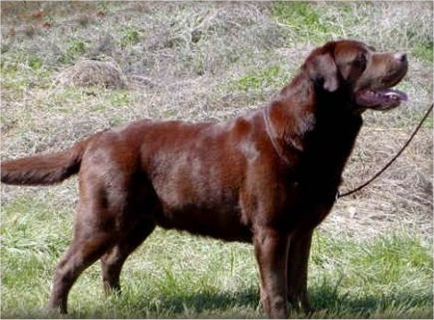
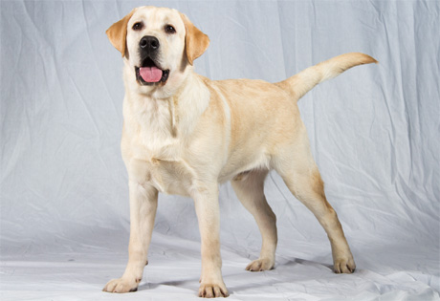
Labrador Retriever- 407

Slide 11
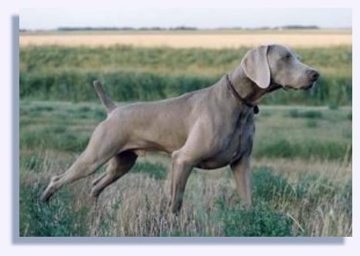
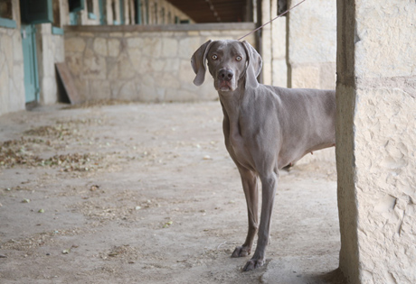
Weimaraner- 408

Slide 12
Non-Sporting Group

Slide 13
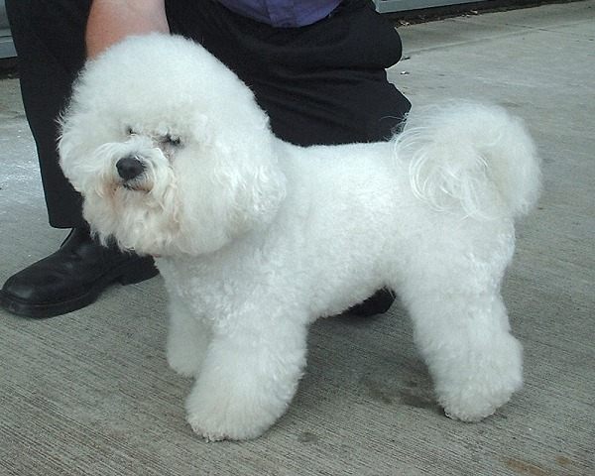
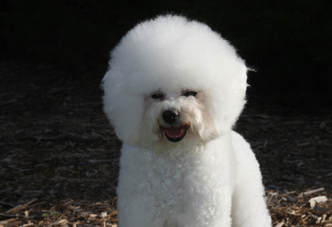
Bichon Frise- 409

Slide 14
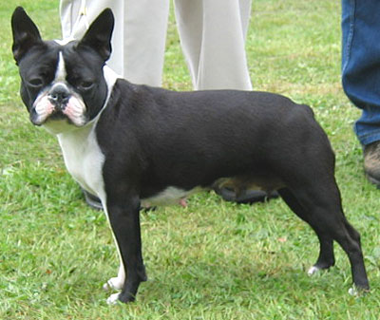
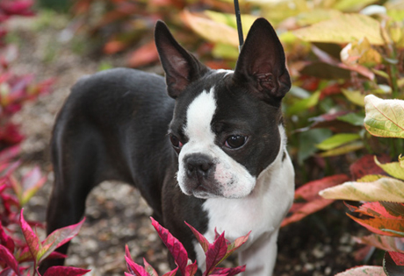
Boston Terrier- 410

Slide 15
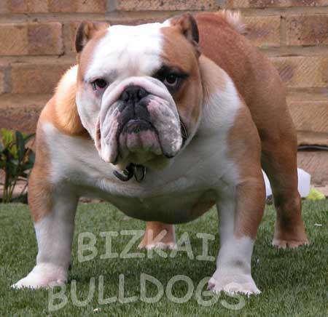
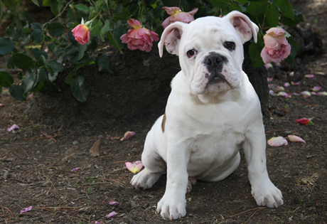
Bulldog-411

Slide 16
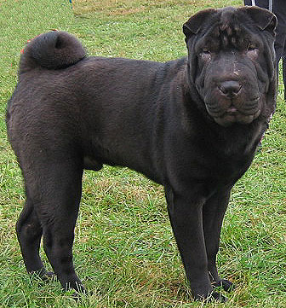
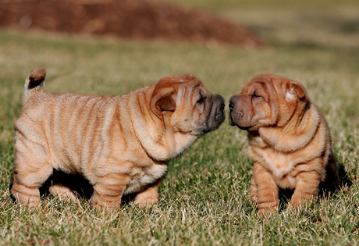
Chinese Shar-Pei-412

Slide 17
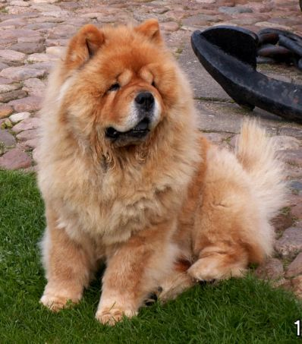
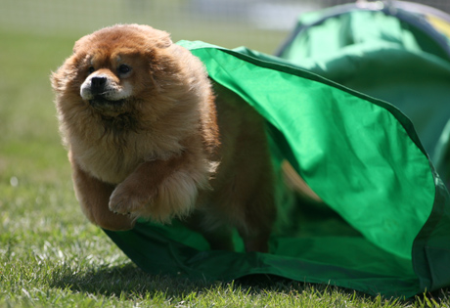
Chow Chow-413

Slide 18
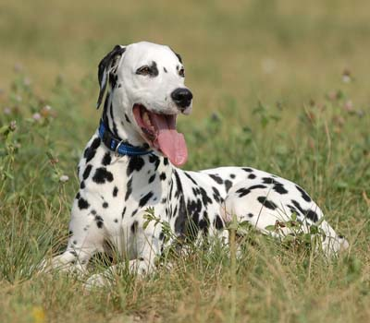
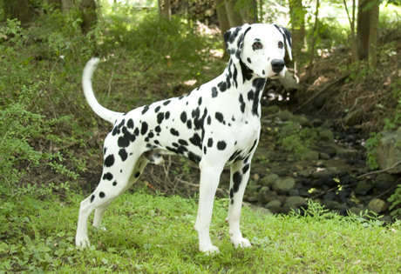
Dalmatian -414

Slide 19
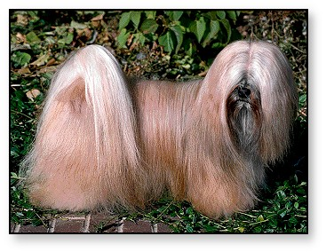
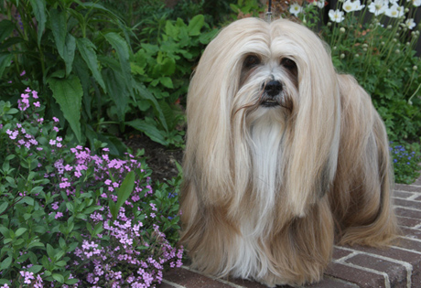
Lhasa Apso-415

Slide 20
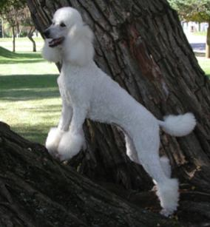
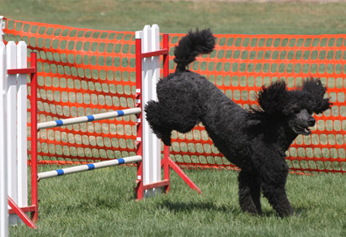
Poodle-416

Slide 21
Terrier Group

Slide 22
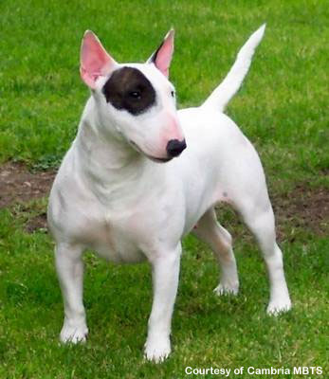
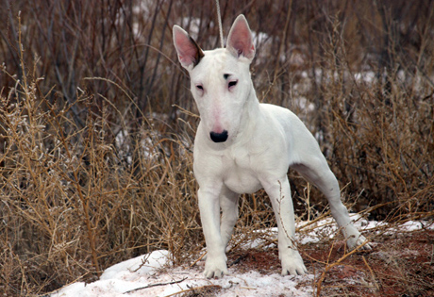
Bull Terrier-417

Slide 23
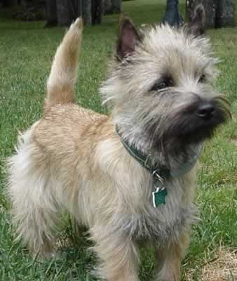
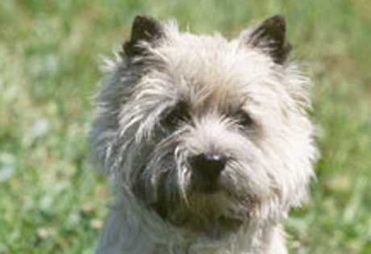
Cairn Terrier-418

Slide 24
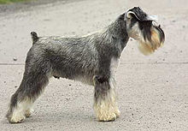
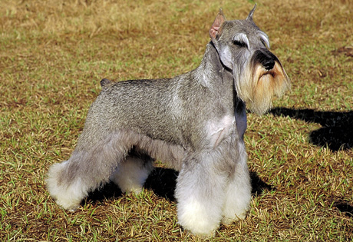
Miniature Schnauzer-419

Slide 25
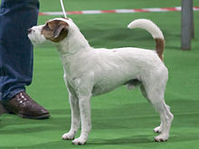
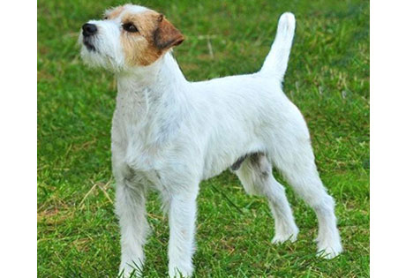
Parson Russell Terrier-420

Slide 26
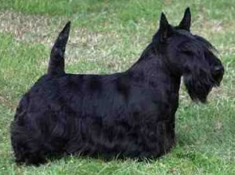
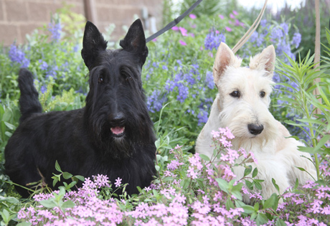
Scottish Terrier-421

Slide 27
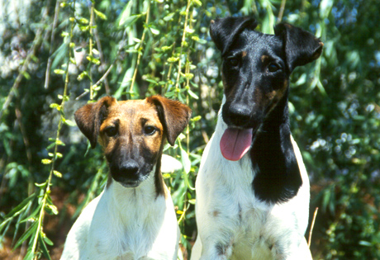
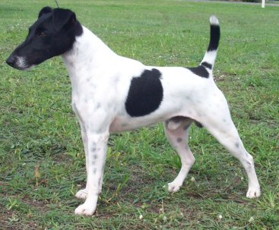
Smooth Fox Terrier-422

Slide 28
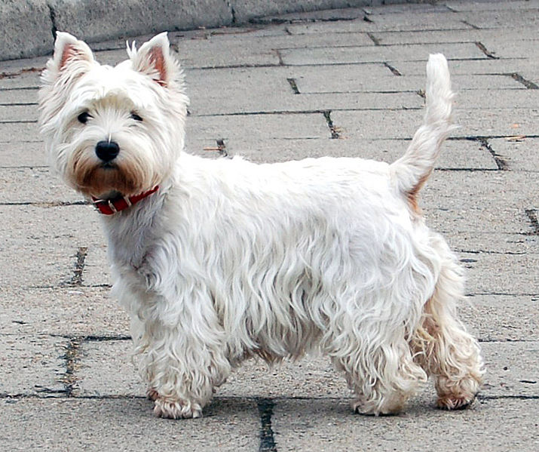
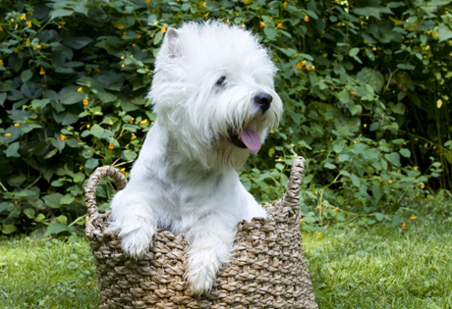
West Highland White Terrier-423

Slide 29
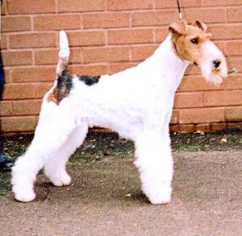
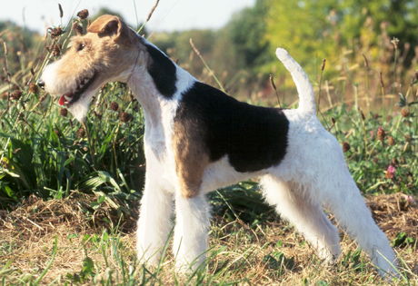
Wire Fox Terrier-424

Slide 30
Herding Group

Slide 31
Australian Cattle Dog-425

Slide 32
Australian Shepherd-426

Slide 33
Border Collie-427

Slide 34
Cardigan Welsh Corgi-428
Cardigan Welsh Corgis have larger ears, longer tails and "quieter" personalities.

Slide 35
Collie-429
Smooth
standard

Slide 36
German Shepherd Dog-430

Slide 37
Old English Sheepdog-431

Slide 38
Pembroke Welsh Corgi-432
Pembroke Welsh Corgis usually have bobbed tails and foxier ears

Slide 39
Shetland Sheepdog-433

Slide 40
Working Group

Slide 41
Akita-434

Slide 42
Alaskan Malamute-435

Slide 43
Bernese Mountain Dog-436

Slide 44
Boxer-437

Slide 45
Bullmastiff-438

Slide 46
Doberman Pinscher-439

Slide 47
Giant Schnauzer-440
Salt and Pepper or Solid Black

Slide 48
Great Dane-441

Slide 49
Great Pyrenees-442

Slide 50
Mastiff-443

Slide 51
Newfoundland-444

Slide 52
Portuguese Water Dog-445

Slide 53
Rottweiler-446

Slide 54
Saint Bernard-447

Slide 55
Samoyed-448

Slide 56
Siberian Husky-449

Slide 57
Standard Schnauzer-450

Slide 58
Toy Group

Slide 59
Cavalier King Charles Spaniel-451

Slide 60
Chihuahua-452

Slide 61
Italian Greyhound-453
ideally 13 inches to 15 inches.

Slide 62
Maltese-454

Slide 63
Miniature Pinscher-455

Slide 64
Papillon- 456

Slide 65
Pekingese-457

Slide 66
Pomeranian-458

Slide 67
Poodle-459
Under 10”

Slide 68
Pug-460

Slide 69
Shih Tzu-461

Slide 70
Silky Terrier-462

Slide 71
Toy Fox Terrier-463

Slide 72
Yorkshire Terrier-464

Slide 73
Hound Group

Slide 74
Afghan Hound-465

Slide 75
American Foxhound-466

Slide 76
Basenji-467

Slide 77
Basset Hound-468

Slide 78
Beagle-469

Slide 79
Black and Tan Coonhound-470

Slide 80
Bloodhound-471

Slide 81
Dachshund-472

Slide 82
English Foxhound-473

Slide 83
Greyhound-474

Slide 84
Whippet-475

